Slide 1
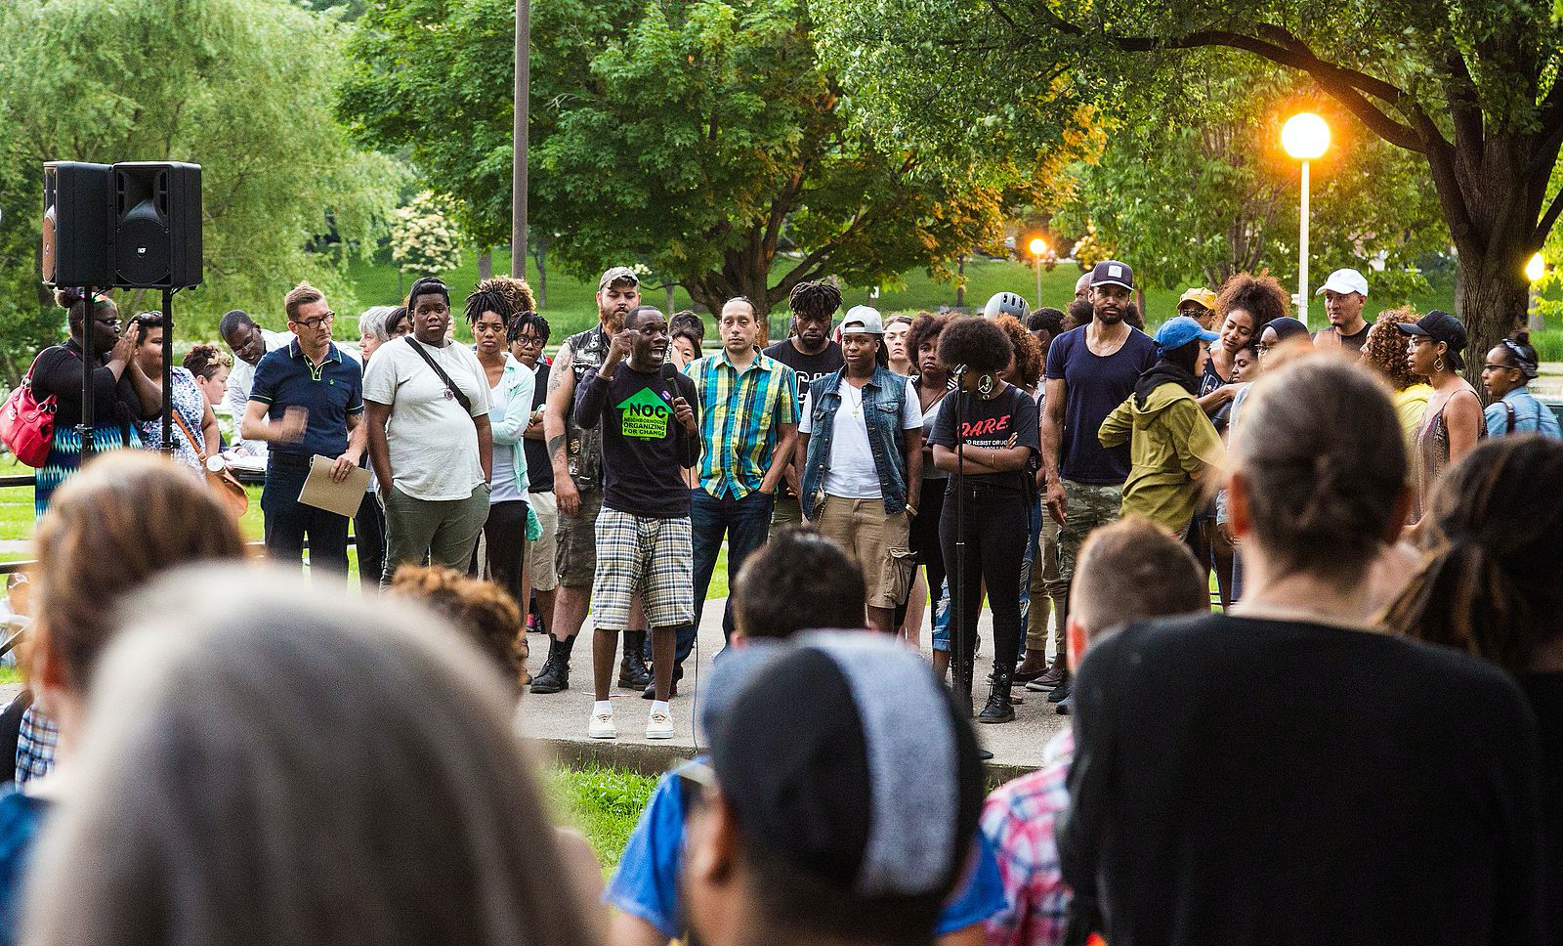

Introduction to Community Psychology
[Professor Name]
[Class and Section Number]
Notes:
Class Recommendations: This lecture is designed for one long-class period (75-90 minutes), but it could be broken up into two shorter class periods (50-60 minutes).
Overview: This module explores core themes within the field of Community Psychology, which include an emphasis on prevention, a social justice orientation, and an ecological understanding of how people are affected by their environments. Community psychologists comprehensively analyze, investigate, and address problems such as economic inequality, violence, substance abuse, homelessness, poverty, and racism. This unique discipline encourages active collaboration with community partners and organizations to promote a fair and equitable allocation of resources and opportunities. Finally, this module reviews the methods used by community psychologists as well as provides resources for learning more about and getting involved within this field.
Additional Instructions: Students will begin with a warm-up to get them to consider and reflect on their communities, and how they might be able to use a Community Psychology framework to create long-term change. Next, students will learn about the recurring themes of prevention, social justice, and using an ecological perspective. Students will be asked to critically think about the different ecological factors and levels of analysis that operate in the lives of individuals and communities, as well as developing an ecological lens with a social justice orientation when evaluating social and institutional systems in society. There are additional class activities to aid students in understanding the fundamental features of Community Psychology as a subdiscipline of psychology. A brief overview of the research methods commonly utilized by community psychologists will be presented with real world applications.
Technical Note: These slides may contain simple click animation so that you can focus students’ attention on a particular question, a selection of text, or an image and not have them be distracted by reading ahead. You can either preview the sequence of animation by going through the slides in slideshow view, visiting the animations tab, or reviewing the slide notes. In the notes you will see a cue - (Click) – that corresponds to each animation.
You may also find hyperlinks to outside videos at various places in the slides. These hyperlinks are embedded in text and indicated by color and in the notes section.

Slide 2
Learning Objectives
Understand the differences between prevention and treatment.
Differentiate interventions that bring about short-term versus long-term change.
Appreciate the many layers of community interventions.
Identify critical elements of the Community Psychology approach.
Notes:
Purpose: This slide outlines the learning objectives of the module.

Slide 3
Warm Up Activity: My Community
Think of a community you are a part of. When thinking of a community:
In groups or pairs, share:
Which community you chose
How does this community affect your identity
What characteristics do you share with other members of your chosen community
Notes:
Purpose: This slide outlines a warm-up activity.
Time: 10-15 minutes
Materials: The warm up slide. Students need paper and writing utensil.
(Click): Think of a community you are a part of? When thinking of a community:
To begin the class, ask students to reflect on the different communities they are a part of.
(Click): In Group or Pairs, share: (3-5 minutes)
Have students get into groups of two or three to discuss their thoughts. Give students three to five minutes to share which community they chose and how their identities are affected by their chosen communities and what characteristics do they share with other members of their chosen community.
(Click): Which community you chose
(Click): How does this community affect your identity
(Click): What characteristics do you share with other members of your chosen community
Tell the class that when discussing the ideas with their partner, they should:
Take turns, and try to have an equal speaking time
Listen carefully and ask clarifying questions of one another
You should be able to explain your partner’s thinking, as well as your own
Feel free to write notes as you discuss with your partner
Once conversations begin to quiet, ask for some groups to share with the class. Ideas can be shared on a chalkboard or whiteboard.
Use this brief discussion to highlight how community psychologists go beyond the narrow definition of a “community” and that we are affected by our communities and often share many characteristics of other members of our communities.

Slide 4
Overview
Defining Community Psychology
Approach
Themes and values
Role of Prevention
A Social Justice Orientation
A Shift in Perspective: The Ecological Model
The Science of Community Psychology
Notes:
Purpose: The purpose of this slide is to provide students with an overview of the material that will be covered during the lecture.

Slide 5
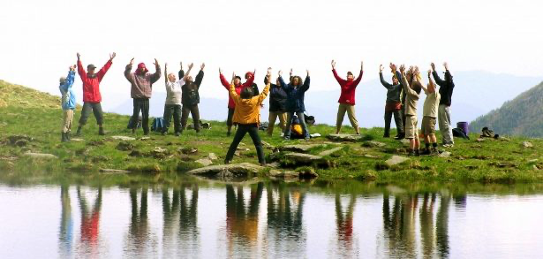
Defining Community Psychology
Community Psychology: the branch of psychology that approaches individual- and community-level problems by examining the relationship between an individual and context/environment
Notes:
Purpose: The purpose of this slide is to teach students about Community Psychology’s method of operation, in other words, how it functions.
(Click): Approach
Community Psychology is the study of the reciprocal relationship between individuals and their context and/or environments. This field seeks to alleviate and prevent societal issues (e.g., poverty, homelessness, addiction) by shifting the focus beyond an individual and integrates social, cultural, economic, political, environmental, and international influences to promote positive change, health, and empowerment at individual and systemic levels such as the education system or justice system (SCRA27.org). One distinguishing feature of Community Psychology is that it is a value driven science and it seeks to balance objectivity with guiding principles [next slide].
Reference: What is community psychology? Retrieved from https://www.scra27.org/what-we-do/what-community-psychology/

Slide 6
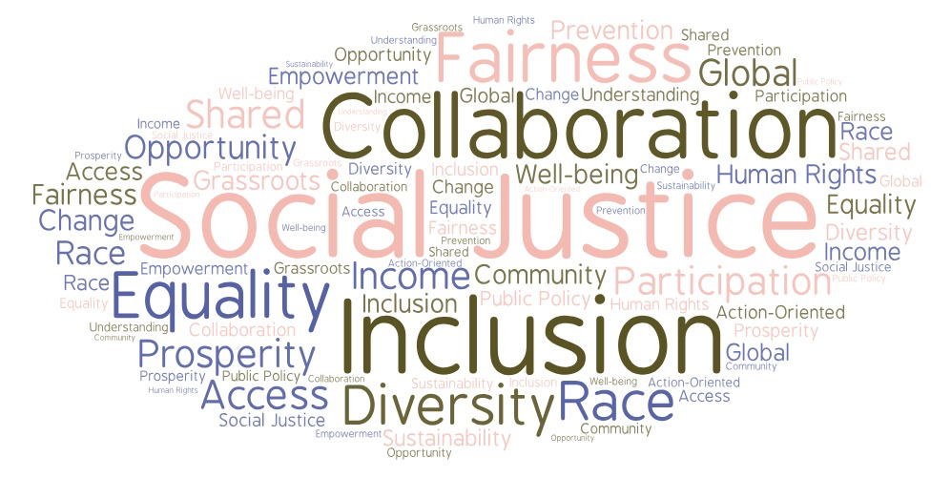
Defining Community Psychology, cont.
Important Themes: prevention, social justice, ecological understanding
Important Principles: respect for diversity, collaboration, sense of community, policy change, and empowerment
Notes:
Purpose: The purpose of this slide is to continue to teach students about recurring themes found in Community Psychology, and the principles that guide community psychologists’ action and research.
(Click): Important Themes
Important themes include prevention, social justice, and ecological understanding.
(Click): Important Principles
Important principles include respecting diversity, encouraging collaboration, promoting a sense of community, focusing on policy change, and bringing about empowerment.

Slide 7
Overview
Defining Community Psychology
Role of Prevention
Focus on prevention
First-order change
Second-order change
A Social Justice Orientation
A Shift in Perspective: The Ecological Model
The Science of Community Psychology
Notes:
Purpose: The purpose of this slide is to provide students with an overview of the material that will be covered during the lecture.

Slide 8
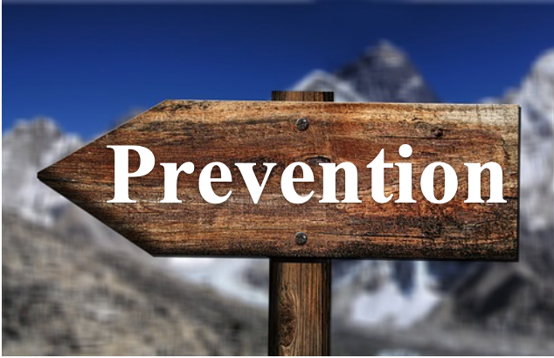
Role of Prevention
Focus on prevention, rather than treatment of social and psychological problems
Boosting individual skills
Engaging in environmental change (e.g., policy work)
Notes:
Purpose: The purpose of this slide is to teach students prevention, and how community psychologists can address the root of an issue to try to alleviate and prevent social and psychological problems from occurring.
(Click): Focus on Prevention
Prevention, one of three primary characteristics of the field, are actions that stop problems from occurring. By examining the root of an issue, we have a more holistic understanding of why something happens. These actions can include boosting a person’s skillset or engaging in environmental change.
(Click): Boosting Individual Skills
Changing something with the individual to better fit in within a setting. For example, providing prevention training for youth to help them resist the urge to use tobacco products.
(Click): Engaging in Environmental Change
Concentrating on systems and structures involved in the problem to modify the person-setting fit. For example, one could address policies regarding youth tobacco access.

Slide 9

First-Order Change
Surface change (i.e., direct intervention with an individual) to create short-term improvements of social and psychological problems
Does not change the context/environment
Individualistic perspective
Notes:
Purpose: The purpose of this slide is to teach students about first-order change, which may occur when interventions are directed at an individual.
(Click): Surface Changes
First-order change occurs when minor actions (i.e., interventions) are successfully directed at a person. For example, encouraging someone experiencing addiction to participate in Alcoholics Anonymous or harm reduction groups.
(Click): No Change in Context
The individual is adjusted to create a short-term difference in the individual-environment relationship. One well known example of this could be providing a temporary shelter at night, as well as access to a food kitchen, to a person experiencing homelessness.
(Click): Individualistic Perspective
The focus is on the individual where the influence of larger environmental or societal factors is not attended to.

Slide 10

Second-Order Change
System change (i.e., working with systems and structures) to create long-term improvements
Goes beyond the individual
Changes the context/environment
Preventive approach
Notes:
Purpose: The purpose of this slide is to teach students about long-term changes, known as second-order change, which occur when actions are directed at systems and structures (e.g., institutions).
(Click): Systems Change
Second-order change occurs when there are improvements in a larger system or structure.
(Click): Goes Beyond the Individual
Second-order change strategies aim to target social factors (e.g., family; peers), community factors (e.g., policing policies; local health services), and societal factors (e.g., healthcare policies; federal regulation; taxation). In this case, the context or environment around an individual is altered in an attempt to create a long-term difference in the individual-environment relationship.
(Click): Changes in Context/Environment
Actions are directed at the ecological factors that influence a person’s feelings, thoughts, and behavior, in order to create more sustainable and long-term improvements. One example comes from community psychologists Zimmerman and colleagues, who investigated what factors cultivate a safe and healthy environment. They found that improving physical features of neighborhoods (e.g., fixing abandoned housing, cutting long grass, picking up trash, and planting a garden) resulted in roughly 40% fewer assaults and violent crimes compared to street segments with vacant and abandoned lots (Heinze et al., 2018).
(Click): Preventive Approach
Second-order change is considered a preventive approach. This approach consists of strategies that may get to the root of the problem by affecting the larger context that the individual is apart of. These types of changes are typically sustained for longer periods of time and can result in preventing the problem completely.
Reference:
Heinze, J. E., Krusky-Morey, A., Vagi, K. J., Reischl, T. M., Franzen, S., Pruett, N. K., … Zimmerman, M. A. (2018). Busy streets theory: The effects of community-engaged greening on violence. American Journal of Community Psychology, 62(1-2), 101-109. doi:10.1002/ajcp.12270

Slide 11
Activity: Creating Change!
Imagine your campus has a beautiful lake with a long sandy beach and is surrounded by high cliffs. You notice a student who fell from one of the cliffs and who is now flailing about in the water. The lifeguard jumps in the water to save him. A bit later, another student wades too far into the water and panics as he does not know how to swim, and the lifeguard again dives into the water to save him. This pattern continues day after day.
Notes:
Purpose: The purpose of this activity is to develop the students’ abilities to understand the types of change in Community Psychology.
Time: 15-20 minutes
Materials: Activity: Creating Change PowerPoint slide and the next slide – Creating Change Continued.
(Click): Imagine…
Read vignette: Imagine your campus has a beautiful lake with a long sandy beach and is surrounded by high cliffs. You notice a student who fell from one of the cliffs and who is now flailing about in the water. The lifeguard jumps in the water to save him. A bit later, another student wades too far into the water and panics as he does not know how to swim, and the lifeguard again dives into the water to save him. This pattern continues day after day.
Discuss the following questions with a partner (5 minutes)
What are some first-order changes that might be of help to your fellow peers?
Using the preventive approach, what are some second-order changes that could be of help to them?
Tell the class that when discussing with their partner, they should:
Take turns and try to have an equal speaking time.
Listen carefully and ask clarifying questions of one another.
You should be able to explain your partner’s thinking, as well as your own.
Feel free to write notes as you discuss with your partner.
Instructors Note: Please go to the next slide after explaining the rules below, it displays these questions so students can keep track of them and don’t have to memorize them.

Slide 12
Activity: Creating Change! cont.
Discuss the following questions with a partner
What are some first-order changes that might be of help to your fellow peers?
Using the preventive approach, what are some second-order changes that could be of help to them?
Notes:
Purpose: The Creating Change! Activity continued.
Time: 15-20 minutes
Materials: This slide
Discuss the following questions with a partner (5 minutes)
What are some first-order changes that might be of help to your fellow peers?
Using the preventive approach, what are some second-order changes that could be of help to them?
This slide displays these questions so students can keep track of them and don’t have to memorize them.

Slide 13

CAT: The Muddiest Point
What was the muddiest point in today’s class?
Write down what concept you are still struggling to understand.
Notes:
Classroom Assessment Technique (CAT): The Muddiest Point
Time: 2-3 minutes
Materials: The “CAT” slide (see PowerPoint slides). Students need a piece of paper.
Ask students to write down the “muddiest point” – that is any concept they are still struggling to understand of any questions they still may have about the material. With remaining class time, ask students to share their muddiest point and provide additional review on these points.
If you do not conclude with this Classroom Assessment Technique (CAT), it would helpful to use another CAT. It could be in the form of a:
Muddy point
One-minute paper
Background knowledge
What’s the Principle?
Defining features Matrix:
For more information on CATs click here: http://cft.vanderbilt.edu/guides-sub-pages/cats/
If you are doing this lesson in two class sessions, THIS IS THE END OF CLASS 1.
Review answers after class and use students’ responses to help guide your review at the start of day 2.

Slide 14
Overview
Defining Community Psychology
Role of Prevention
A Social Justice Orientation
Social Justice
Application of Social Justice Orientation
A Shift in Perspective: The Ecological Model
The Science of Community Psychology
Notes:
Purpose: The purpose of this slide is to provide students with an overview of the material that will be covered during the lecture.

Slide 15

Social Justice Orientation
Orient action and research around:
Equal distribution of resources
Reduction of barriers to resources
Fair and equal treatment
Promotion of self-determination
Social Justice + Orientation = Framework that aims to assist people and groups who have historically been marginalized and oppressed
Notes:
Purpose: The purpose of this slide is to show students how social justice can be used as a framework to direct community action and research.
(Click): Equal distribution of resources
Everyone receives the same amount of a certain good or service.
(Click): Reduction of barriers to resources
Challenges or obstacles that obstruct communities from accessing a good or service are lessened in size or degree, or even eliminated.
(Click): Fair and equal treatment
Communities and groups are treated fairly and equally.
(Click): Promotion of self-determination
Increase of the belief that people have a right to control their own destiny.
(Click): Social Justice Orientation
This is a way of perceiving an issue that examines how oppressive social systems preserve classism, sexism, racism, homophobia, and other forms of discrimination and domination that perpetuate social injustice (Kagan, 2011).
Reference: Kagan, C., Burton, M., Duckett, P., Lawthom, R., & Siddiquee, A. (Eds.). (2011). Critical Community Psychology (1st ed.). West Sussex, UK: Wiley-Blackwell.

Slide 16
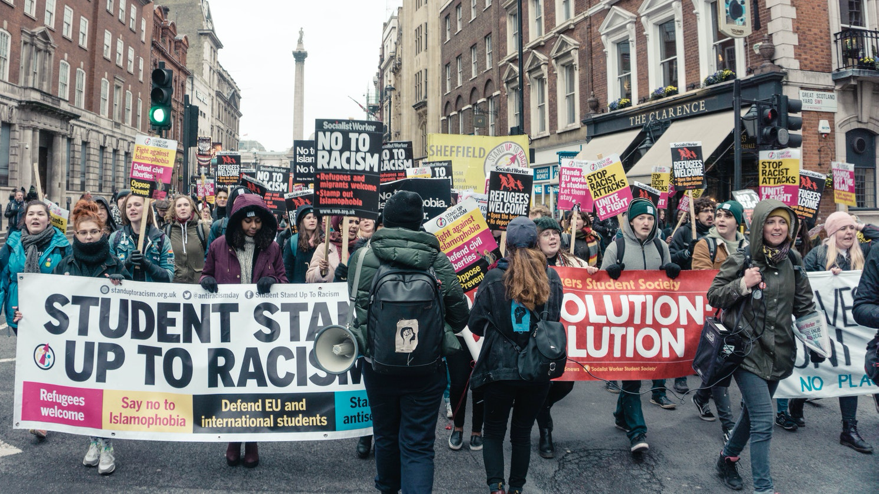
SJO (Social Justice Orientation) Activity:
In pairs or small groups, agree upon a social issue that you are able to examine using a social justice orientation.
Notes:
Purpose: The purpose of this activity is to encourage students to practice innovative and critical thinking skills, while also incorporating sociocultural factors into their methods of problem solving.
Time: 15-20 minutes
Materials: The SJO Activity slide and the next slide SJO Activity Continued, chalkboard and chalk or whiteboard and marker.
Introduce a “Think-Pair-Share” activity.
(Click): In pairs or small groups, agree upon a social issue that you are able to examine using a social justice orientation. (3-5 minutes)
Pairs will then discuss the following (10 minutes):
How do social and economic inequities contribute to the root problems of your group’s social issue?
What systemic injustices occur, and how might these systemic factors be misapplied (i.e., attributed to the individual such as people with SUD being at fault for their illness)?
How might a community psychologist approach this issue by reallocating resources, reducing barriers, or promoting self-determination and well-being?
Instructors Note: Please go to the next slide after explaining the rules below, it displays these questions so students can keep track of them and don’t have to memorize them.
Tell the class that when discussing with their partner, they should:
Take turns and try to have an equal speaking time.
Listen carefully and ask clarifying questions of one another.
You should be able to explain your partner’s thinking, as well as your own.
Feel free to write notes as you discuss with your partner

Slide 17
SJO (Social Justice Orientation) Activity cont.:
How do social and economic inequities contribute to the root problems of your group’s social issue?
What systemic injustices occur, and how might these systemic factors be misapplied (i.e., attributed to the individual such as people with SUD being at fault for their illness)?
How might a community psychologist approach this issue by reallocating resources, reducing barriers, or promoting self-determination and well-being?
Notes:
Purpose: The SJO Activity continued.
Time: 15-20 minutes
Materials: This slide.
Pairs discuss the following (10 minutes):
How do social and economic inequities contribute to the root problems of your group’s social issue?
What systemic injustices occur, and how might these systemic factors be misapplied (i.e., attributed to the individual such as people with SUD being at fault for their illness)?
How might a community psychologist approach this issue by reallocating resources, reducing barriers, or promoting self-determination and well-being?

Slide 18
Overview
Defining Community Psychology
Role of Prevention
A Social Justice Orientation
The Ecological Model
The Ecological Theory
Ecological Theory Principles
The Science of Community Psychology
Notes:
Purpose: The purpose of this slide is to provide students with an overview of the material that will be covered during the lecture.

Slide 19
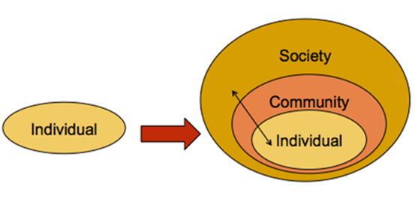
The Ecological Theory
Ecological theory (Kelly, 1966)
Levels of analysis
Individual/personal level
Social level
Community level
Societal level
Notes:
Purpose: This slide is meant to teach students about ecological theory.
(Click): Ecological theory
The purpose of this theory is to provide a framework for understanding the structure and function of community (Kelly, 1966). It helps to understand the relationships between people and their social environments (e.g., families, groups, communities, and societies).
(Click): Levels of Analysis
The levels of analysis can be thought of as the various levels of interaction that a person lives with, each of them nested within one another. Each level is a step closer to, or further from, the individual.
(Click): Individual/personal factors
These include personal factors such as personality traits.
(Click): Social factors
These include social factors such as family upbringing.
(Click): Community factors
These include community factors such as cultural or gender norms.
(Click): Societal factors
These include societal factors such as public policies.
Reference: Kelly, J. G. (1966). Ecological constraints on mental health services. American Psychologist, 21, 535-539.

Slide 20
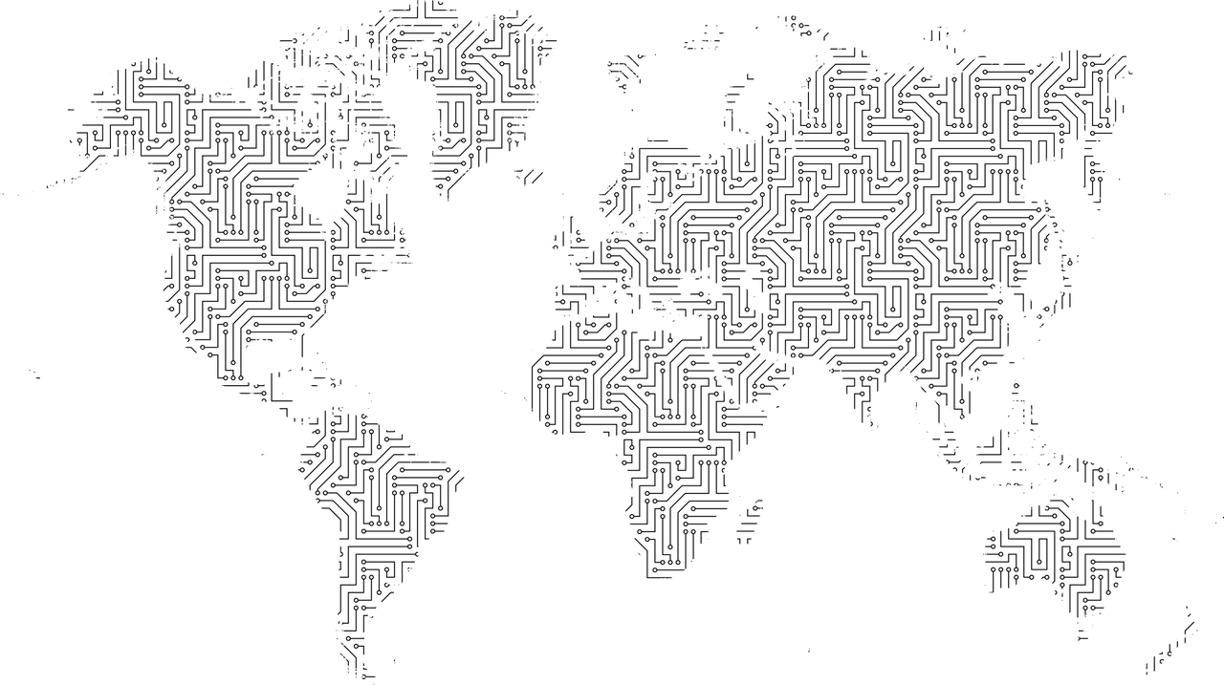
Ecological Theory Principles
Ecological theory principles (Kelly, 2006)
Interdependence: Interconnected
Adaptation: Shaped and changed
Notes:
Purpose: This slide is meant to teach students about the foundation of how ecological theory works.
(Click): Ecological theory principles (Kelly, 2006)
Each principle helps promote understanding of how social environments affect and influence people.
(Click): Interdependence
Everything is connected, changing one aspect of an environment will have many ripple effects.
(Click): Adaptation
Focuses on interactions between persons and their environments to better understand why behavior that is effective in one setting may not be useful in others.
Reference: Kelly, J. G. (2006). Being ecological: An expedition into Community Psychology. New York, NY: Oxford University Press.

Slide 21
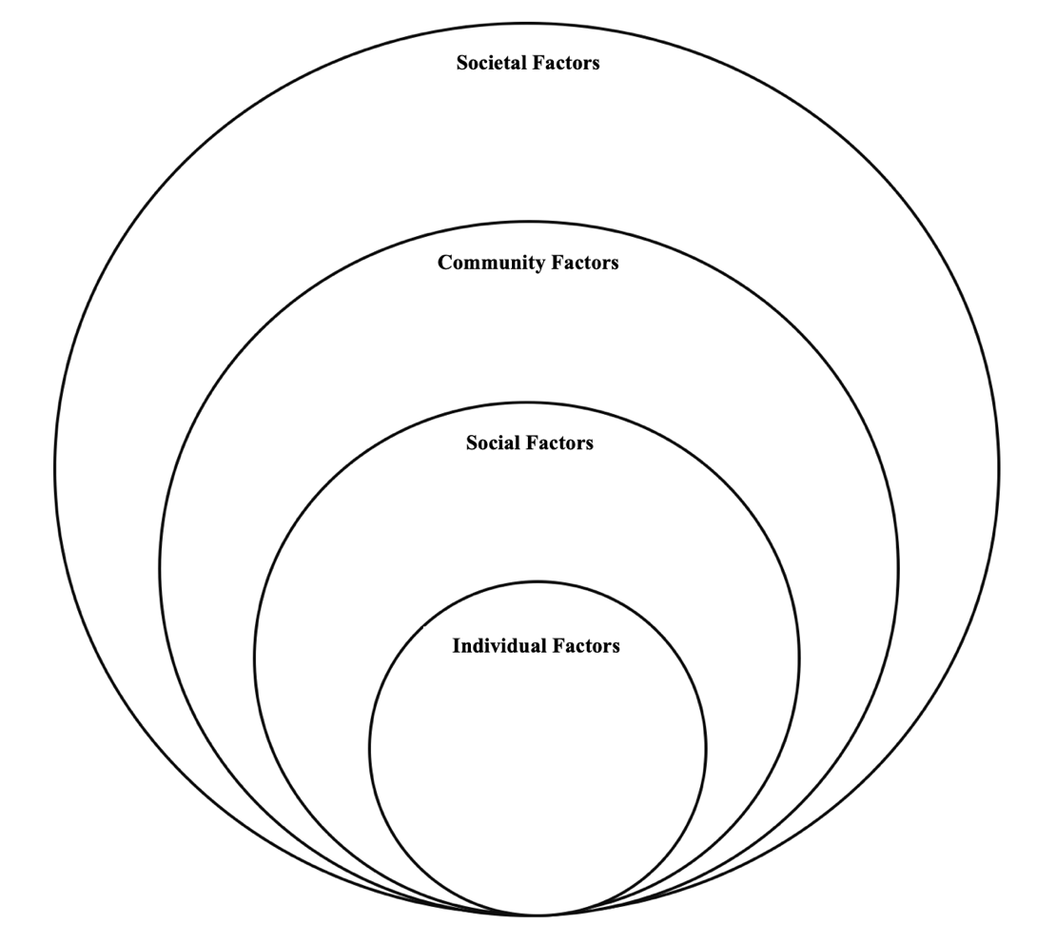
Advocacy Self-Assessment Tool
Create your own ecological model.
Fill in the personality traits, social factors, community factors, and societal factors that influence you!
Notes:
Purpose: The purpose of this activity is for students to gain familiarity with the different ecological levels in their own lives.
Time: 20-25 minutes
Materials: The slides that cover the Advocacy Self-Assessment Tool activity, chalkboard and chalk or whiteboard and marker. Students will need a writing utensil and a sheet of paper.
(Click): Create your own ecological model.
(Click): Fill in the personality traits, social factors, community factors, and societal factors that influence you! (5 minutes)
Ask students to reflect on their lives until this point. Ask them to consider the different levels of factors (i.e., individual, social, community, and societal) and to write them down on the piece of paper, they can copy the diagram from this slide and write in their answers.
Read the instructions: “To complete the self-assessment in this activity box, first consider several social issues with which you are interested in engaging in advocacy work. Once you have selected the social issues, complete the self-assessment questions for each social issue. Then, total up your scores for each issue to determine which received the high score”.
Here are some examples to assist students: Individual factors (e.g., personality traits), social factors (e.g., friends, significant others, parents, siblings, grandparents, children), community factors (e.g., your neighborhood, grocery stores, schools), and societal factors (e.g., local laws, social or gender norms).
Instructors Note: Please go to the next slide after explaining the directions above, it displays the diagram so students can better see what is on the handout.

Slide 22
Advocacy Self-Assessment Tool cont.
1 = Strongly Disagree, 2 = Disagree, 3 = Neither Agree/Disagree, 4 = Agree, 5 = Strongly Agree
Notes:
Purpose: Advocacy Self-Assessment Tool activity continued
Time: 20-25 minutes
Materials: Advocacy Self-Assessment Tool activity slides, chalkboard and chalk or whiteboard and marker, and handout. Students will need a writing utensil and a sheet of paper.
(Click): Read the instructions:
“This will help you determine what you are most passionate about.
Using the range below, rate your agreement to each question for each of your chosen issues. Once you have determined which social issues might best fit your advocacy competencies and commitment, consider making a plan for your involvement. For the issue you score highest on, develop a plan to advocate directly and indirectly to initiate social change through policy. Here is how to rate the items:
1 = Strongly Disagree, 2 = Disagree, 3 = Neither Agree/Disagree, 4 = Agree, 5 = Strongly Agree
Instructors Note: Please go to the next slide after explaining the directions above, it displays the diagram so students can better see what is on the handout.

Slide 23
Advocacy Self-Assessment Tool
COMMITMENT
1. Are you strongly committed to working on this issue?
2. Are you willing to put in a great effort to achieve this goal?
3. Would you be willing to spend many years working on this issue?
4. Do you have a sense of obligation to continue working on this issue above all others?
CENTRALITY
1. Is what you have listed more important than any other issue you could work on?
2. Is this a matter of great personal meaning to you?
3. Do you have a passion and a burning desire to see this issue dealt with?
4. Is this an issue that you devote a lot of time thinking about?
Notes:
Purpose: Ecological Model Activity continued.
This slide displays the items that students will need to rate 1 through 5 once they’ve selected the issues to work on.
Class Discussion and Sharing (5-10 minutes)
Ask for some groups to share with the class. Ideas can be shared on a chalkboard or whiteboard. You as the instructor may share your reflections on a chalkboard or whiteboard, as a way of demonstrating your willingness to participate in the activity.
After students have shared their thoughts and engaged in a large group discussion about the factors they have identified, this is a great opportunity for students to share how their cultural/historical/regional upbringing influenced the ways in which they experienced their collegiate journey.

Slide 24
Advocacy Self-Assessment Tool
RESOURCES
1. Are you a member of or work with any activist groups or community organizations that are dealing with the topic you have selected?
2. Are you aware of any friends, family members or colleagues who are either working on this issue or interested in doing so?
3. Do you have access to resources (time, energy, funds, materials) that might be applied to working with this topic?
4. Do you feel that you have the capabilities and confidence to engage in work with the issue that you have mentioned?
Notes:
Purpose: Ecological Model Activity continued.

Slide 25
Overview
Defining Community Psychology
Role of Prevention
A Social Justice Orientation
A Shift in Perspective: The Ecological Model
The Science of Community Psychology
Research Methods
Types of Research
Notes:
Purpose: The purpose of this slide is to provide students with an overview of the material that will be covered during the lecture.

Slide 26

Research Methods
Quantitative
Qualitative
Mixed-methods
Notes:
Purpose: The purpose of this slide is to teach students about the most common research methods used by community psychologists.
(Click): Quantitative
Methods involving collecting data in the form of numbers using standardized measures in an attempt to produce generalizable findings.
(Click): Qualitative
Methods involving collecting data that typically consist of words that provide comprehensive descriptions of participants’ experiences.
(Click): Mixed-methods
Thoughtful combining of qualitative and quantitative data collection methods.

Slide 27

Types of Research
Action-oriented research
Community-based participatory research
Notes:
Purpose: The purpose of this slide is to teach students about action-oriented research and one evaluative method that link together taking action and doing research.
It is important for community psychologists to critically reflect on their actions and their methodology in this research in order to examine themselves and the research’s impact on the population of interest, making corrections as needed to achieve the best, most ethical outcomes.
(Click): Action-oriented research
An approach and type of research methodology that aims to bring about social change.
(Click): Community-based participatory research
A type of research methodology that involves collaboration between researchers and the community members as issues for action are defined and change interventions are launched. All partners are involved instrumentally in the research process.

Slide 28
CAT: The One-Minute Paper
What was the most important thing you learned during this class?
What important question remains unanswered?
Notes:
Classroom Assessment Technique (CAT): One-Minute Paper
If you are presenting the information on one class day, you might end the material about here. End your class time with a one-minute paper.
The Minute Paper tests how students are gaining knowledge, or not. The instructor ends class by asking students to write a brief response to the following questions: “What was the most important thing you learned during this class?” and “What important question remains unanswered?”
Have students briefly answer these questions in writing and turn them in. After class, assess students’ responses. At the beginning of the next class, go over any misunderstandings or relevant questions.
If you do not conclude with this Classroom Assessment Technique (CAT), it would helpful to use another CAT. It could be in the form of a:
Muddy point
One-minute paper
Background knowledge
What’s the Principle?
Defining features Matrix:
For more information on CATs click here: http://cft.vanderbilt.edu/guides-sub-pages/cats/
THIS IS THE END OF THIS LESSON / CLASS 2.

Slide 29
Additional Outside Resources
Notes:
Purpose: This slide contains additional Outside Resources

Slide 30
Photo Attribution
Slide 1 | Photo Credit: Vigil to Unite in the Wake of the Orlando Shooting” organized by OutFront Minnesota in Loring Park, Minneapolis, Minnesota, the evening of June 12, 2016. Tony Webster https://commons.wikimedia.org/wiki/File:Neighborhoods_Organizing_for_Change_(NOC)_-_Minneapolis_Vigil_(27028755363).jpg#/media/File:Neighborhoods_Organizing_for_Change_(NOC)_-_Minneapolis_Vigil_(27028755363).jpg https://creativecommons.org/licenses/by-sa/2.0/
Slide 5 | Photo Credit: Outdoor Seminar Group Gerhard Lipold https://www.publicdomainpictures.net/en/view-image.php?image=116389&picture=outdoor-seminar-group https://creativecommons.org/publicdomain/zero/1.0/
Slide 6 | Photo Credit: Photo by Olya Glantsman https://creativecommons.org/licenses/by/4.0/
Slide 8 | Photo Credit: Directory geralt https://pixabay.com/photos/directory-board-direction-next-1161965/ https://pixabay.com/service/license/
Slide 9 | Photo Credit: Kaso Individual I-logo https://en.wikipedia.org/wiki/File:Individual-i.svg#/media/File:Individual-i.svg Public Domain
Slide 10 | Photo Credit: fish eye view of city Joshua Rawson-Harris https://unsplash.com/photos/KRELIShKxTM https://unsplash.com/license
Slides 13 and 28 | Photo Credit: Illustrated silhouette of a black cat nehtaeh79 http://www.freestockphotos.biz/stockphoto/16624 http://creativecommons.org/publicdomain/zero/1.0/
Slide 15 | Photo Credit: We Want Justice sign Lorie Shaull https://www.flickr.com/photos/number7cloud/27615432073 https://creativecommons.org/licenses/by-sa/2.0/
Slide 16 | Photo Credit: People walking on street holding banner in between building during daytime Yeo Khee https://unsplash.com/photos/LpBRtSuMLkI https://unsplash.com/license
Slide 19 | Photo Credit: Image by Olya Glantsman https://creativecommons.org/licenses/by/4.0/
Slide 20 | Photo Credit: Cartography GDJ https://pixabay.com/vectors/cartography-continents-earth-3244166/ https://pixabay.com/service/license/
Slide 26 | Photo Credit: Info Kaleidico https://unsplash.com/photos/3V8xo5Gbusk https://unsplash.com/license
Slide 27 | Photo Credit: “Is there grey area here?” Carol VanHook https://www.flickr.com/photos/librariesrock/6784435650 https://creativecommons.org/licenses/by-nc-sa/2.0/
Notes:
Photo Attribution Slide

